Slide 1
Brian Teaser
You have two pieces of rope that take 60 minutes to burn. The ropes however burn at an uneven pace (one half of the rope might take 10 minutes to burn and the other half 50...). You want to time out 45 minutes. Assuming you have the ability to light them however you want, how can you time out 45 minutes?

Slide 2
Answer
Light both ends of one rope and light one end of the other rope at the same time. It will take 30 minutes for the two ends of the first rope to meet. At this point light the other end of the partially burnt rope. 30 minutes of this rope will have already burnt so it will take an additional 15 minutes for the two ends of this rope to meet, thus letting you know when 45 minutes are up

Slide 3
Cornell SEBA

Slide 4
AGENDA
Current Events
Resume Writing
Cover Letters

Slide 5
Current Events

Slide 6
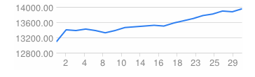
What’s new?
Dow Jones: 13941
US Unemployment: 7.8%
Barrel of oil: $97.40
1.36 Dollar: Euros
Gold: $1660.80 per troy ounce

Slide 7
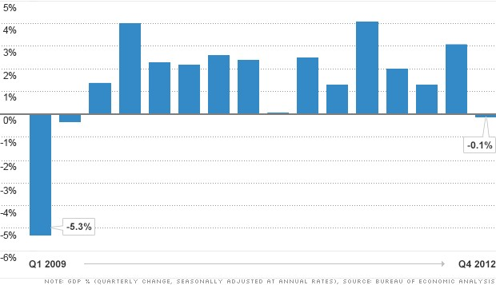
First Decline in Economic Growth Since 2009
Chart in change in adjusted GDP
Notes:
Japan: Deflation

Slide 8
Why?
Likely due to Government cuts
  Most notably in defense spending where there was a 22% cut
"the best-looking contraction in U.S. GDP you'll ever see…The drag from defense spending and inventories is a one-off. The rest of the report is all encouraging.”
  Paul Ashworth, chief U.S. economist for Capital Economics
Notes:
Japan: Deflation

Slide 9
Slowed Economic Growth (contd)
Another main source of slowed growth came from business inventories declining in the fourth quarter
"Businesses were selling in the fourth quarter, but not replacing the stuff on the shelves…When inventories fall in one quarter, they're really likely to rise the next quarter.”
  Bill Hampel, chief economist with the Credit Union National Association
This often signals businesses will have to buy more goods in the upcoming quarter to restock innovatory, possibly leading to stronger growth in the first quarter of 2013.

Slide 10
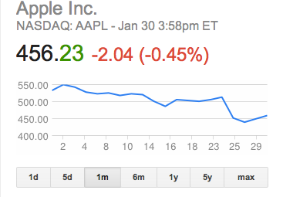
Apple’s Stock Plummets
Apple Shares surged as high as $705.07 back on Sept. 21
Less than a month go Apple’s stock was trading for around $550 a share
Short-term market participants have been using Apple in what is known as pair trades - betting that one stock will go higher while hedging that bet by short-selling a stock expected to go lower.
Essentially the trade has worked like this: One side has used Apple as a stand-in for the computer and telecom industries, while the other component has used some of its direct and indirect competitors against Apple's direction.

Slide 11

Cover Letter Writing
Speaking to the Employer

Slide 12
Cover Letters
Cover letters are an important way to convey your value to employers.
You’ll use them to:
  Introduce yourself to prospective employers while motivating them to read your resume.
  State your career interests and highlight your strengths in relation to job responsibilities.
  Demonstrate your writing skills, professionalism, and courtesy.
  Reveal your personality and enthusiasm for the position, organization, and field.

Slide 13
Cover Letter Do’s and Don’ts
Do
Don’t
• Use standard business-letter format and generous margins.
• Single-space paragraphs and double- space between paragraphs.
• Address the individual by name and use his/her appropriate title.
• Include the person’s full name if you don’t know his/her gender (e.g., “Dear Pat Smith”).
• Attract attention with a strong first paragraph. Limit letter to 3-4 short paragraphs.
• Use the passive voice.
• Include extraneous information.
• Repeat verbatim what’s in your resume.
• Point out weaknesses or lack of experience.
• Begin too many sentences with “I.”
• Use jargon or excessive wordiness.

Slide 14
Cover Letter Do’s and Don’ts
Do
Don’t
• Refer to your enclosed resume.
• Highlight and expand upon the most relevant information in your resume, using specific examples.
• Use correct grammar.
• Ask someone to proofread letters to make sure they are error-free.
• Use high-quality bond paper and envelopes in white, ivory, or light gray.
• Exceed one page.
• Assume spellcheck will identify all errors.
• Overlook signing your letters.
• Emphasize what you hope to get from the experience rather than express what you can contribute.

Slide 15
End Show

Slide 16

Workshop Agenda
Purpose and Impact of a Resume
General Guidelines
Key Components
Optional Categories
Resume Check List
Follow Up

Slide 17
Purpose and Impact

Slide 18
Purpose and Impact
Marketing Tool
  Designed to create a favorable first impression
  Made to get you an interview, not the job
Personal Account of Your:
  Education and Training
  Experience
  Skills and Abilities

Slide 19
Purpose and Impact
Provides an accurate, concise, and original presentation of who you are
Resource for employer at interview
Remember: Employers spend 4 - 5 minutes at most reviewing a resume. Make each word count!

Slide 20
Guidelines

Slide 21
General Guidelines
Length
  Generally one page, one-sided
Layout
  Direct reader’s eye using headings and layout
  Choose standard font in 10-14 point size
  Use high quality 8.5” x 11” paper
  Consider the aesthetics of resume format and avoid a 'cluttered' look

Slide 22
General Guidelines
Layout continued
  Be consistent with:
    Indentations
    Capitalization
    Font
    Spacing

Slide 23
General Guidelines
Content
  Proofread! Don’t rely on spell-check
    grammar
    spelling
    typographical errors
    punctuation
Stress accomplishments and results
Tailor contents to each position (e.g. rewrite Objective/revise Skills section)

Slide 24
Key Components

Slide 25

Resume Key Components
Title and Heading
  Your name
  Current address and home address
  Cell phone number
  Email address

Slide 26
Resume Key Components
EDUCATION
  List highest degree first, followed by other degrees received
  Major(s), minor(s) and emphasis if applicable
  Include other colleges / universities attended
  Date to be conferred
  GPA if 3.0 or higher

Slide 27
Resume Key Components
EXPERIENCE
  Summarize significant full and part time positions
  Include relevant volunteer work, internships, and extra-curricular activities
  Highlight responsibilities, skills developed, and accomplishments
  List job title, employer, city, state, and dates of employment, followed by description

Slide 28

Resume Key Components
EXPERIENCE
  Present information in reverse chronological order
  Create special sections (e.g. Related Experience, Research Experience, Marketing Experience)
  Use action verbs and sentence phrases

Slide 29
Optional Categories

Slide 30
Optional Categories
OBJECTIVE
  Gives resume focus, credibility and direction
  Be concise and logical - develop different resumes for different types of jobs
  Avoid cliches such as “like working with people”
  Emphasize short term aspirations
  Typically at the top of a resume

Slide 31

Optional Categories
SKILLS
  List skills you can perform with little or no direction
  Computer – list software and computing languages
  Laboratory - list techniques, procedures and/or equipment
  Language - indicate fluency level

Slide 32
Optional Categories
Publications
  List articles published and those accepted for publication
Extra-Curricular Activities/Professional Affiliations
  List memberships and offices held
Honors/Awards/Hobbies/Interests
  Avoid listing those which may be controversial

Slide 33
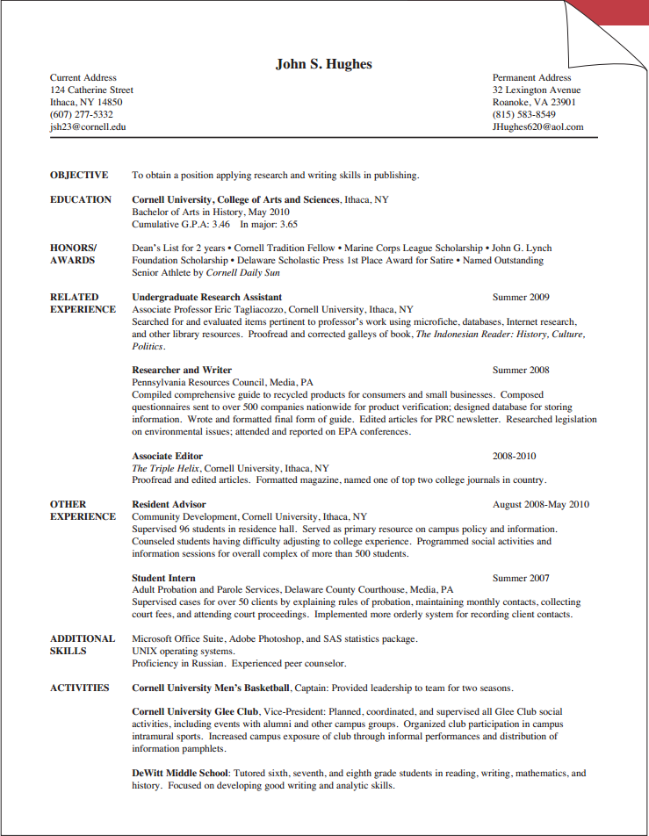
Resume Formats

Slide 34
Resume Checklist

Slide 35
Resume Review Check List
Does your resume look appealing?
Is it clearly labeled, using appropriate headings?
Does it highlight your skills and abilities?
Have you had it critiqued by others?
Have you triple checked for accuracy?

